Slide 1
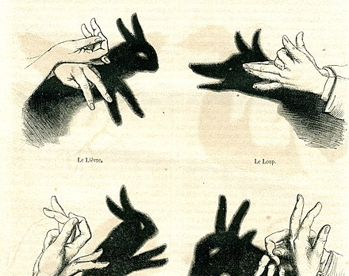
Ombromanie
Jen Looper
Cloud Developer Advocate Lead
Academic Team - Microsoft

Slide 2
Please extinguish all lights

Slide 3
Prepare for some magic

Slide 4
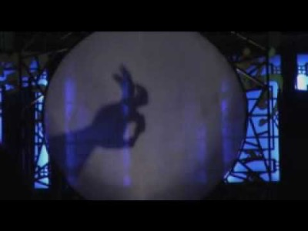
An ancient Chinese folk art

Slide 5
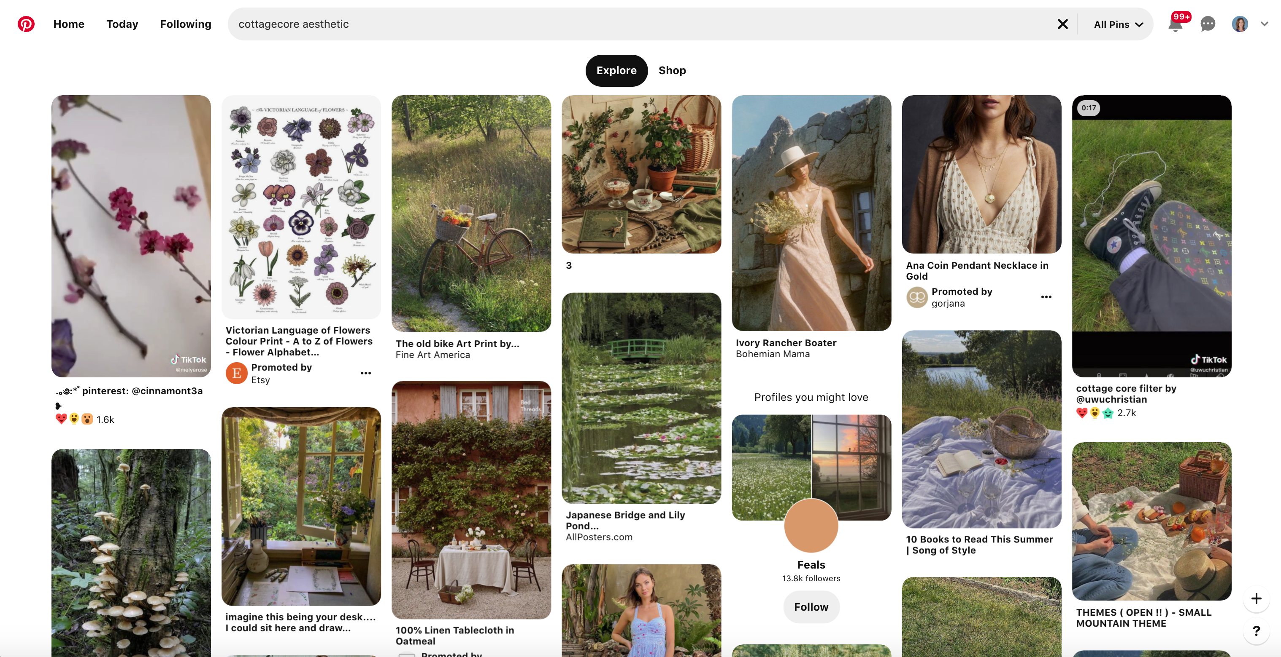
Indulge your #CottageCore

Slide 6
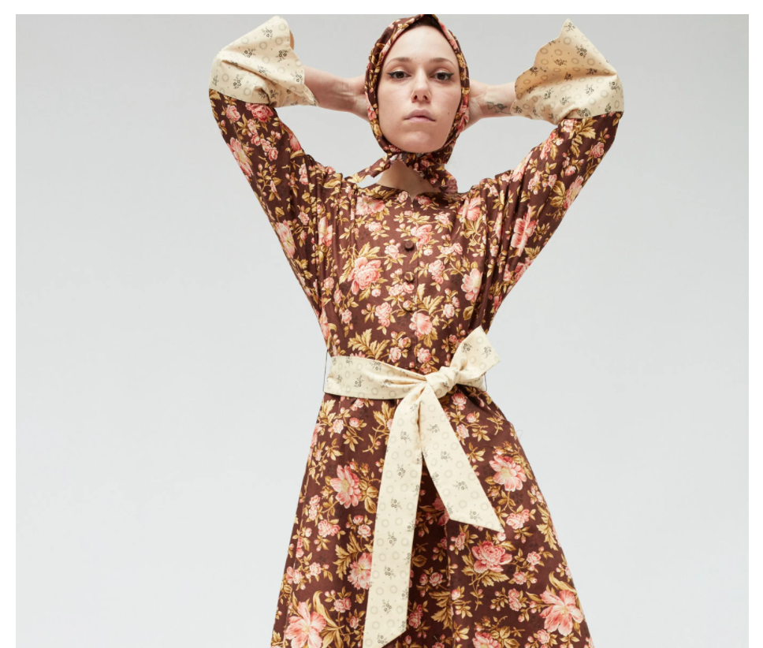
A retreat from the world back to nostalgia
Grab your sunbonnet and let’s go

Slide 7
The Vogue for shadowgraphy
Hand Shadows to be Thrown Upon the Wall by Henry Bursill (1859)
Hand Shadows - Second Series by Henry Bursill (1860)
Home Fun by Cecil H. Bullivant (1910)
The Art of Shadowgraphy - How it is Done by Trewey (1920)
Hand Shadows: The Complete Art of Shadowgraphy by Lois Nikola (1921)
The Art of Hand Shadows by Albert Almoznino (1970)

Slide 8
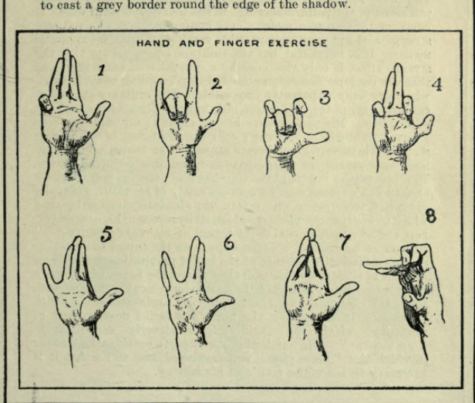
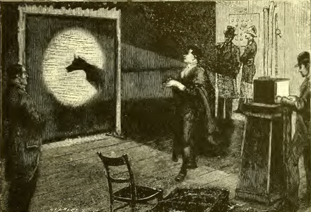
An art for candles or box light, done at home
“ombres chinoises” brought to France in 1776 probably from China, popularized by Felicien Trewey, 1848-1920

Slide 9
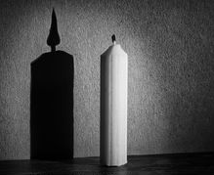
Ephemeral Low-Tech High Art

Slide 10
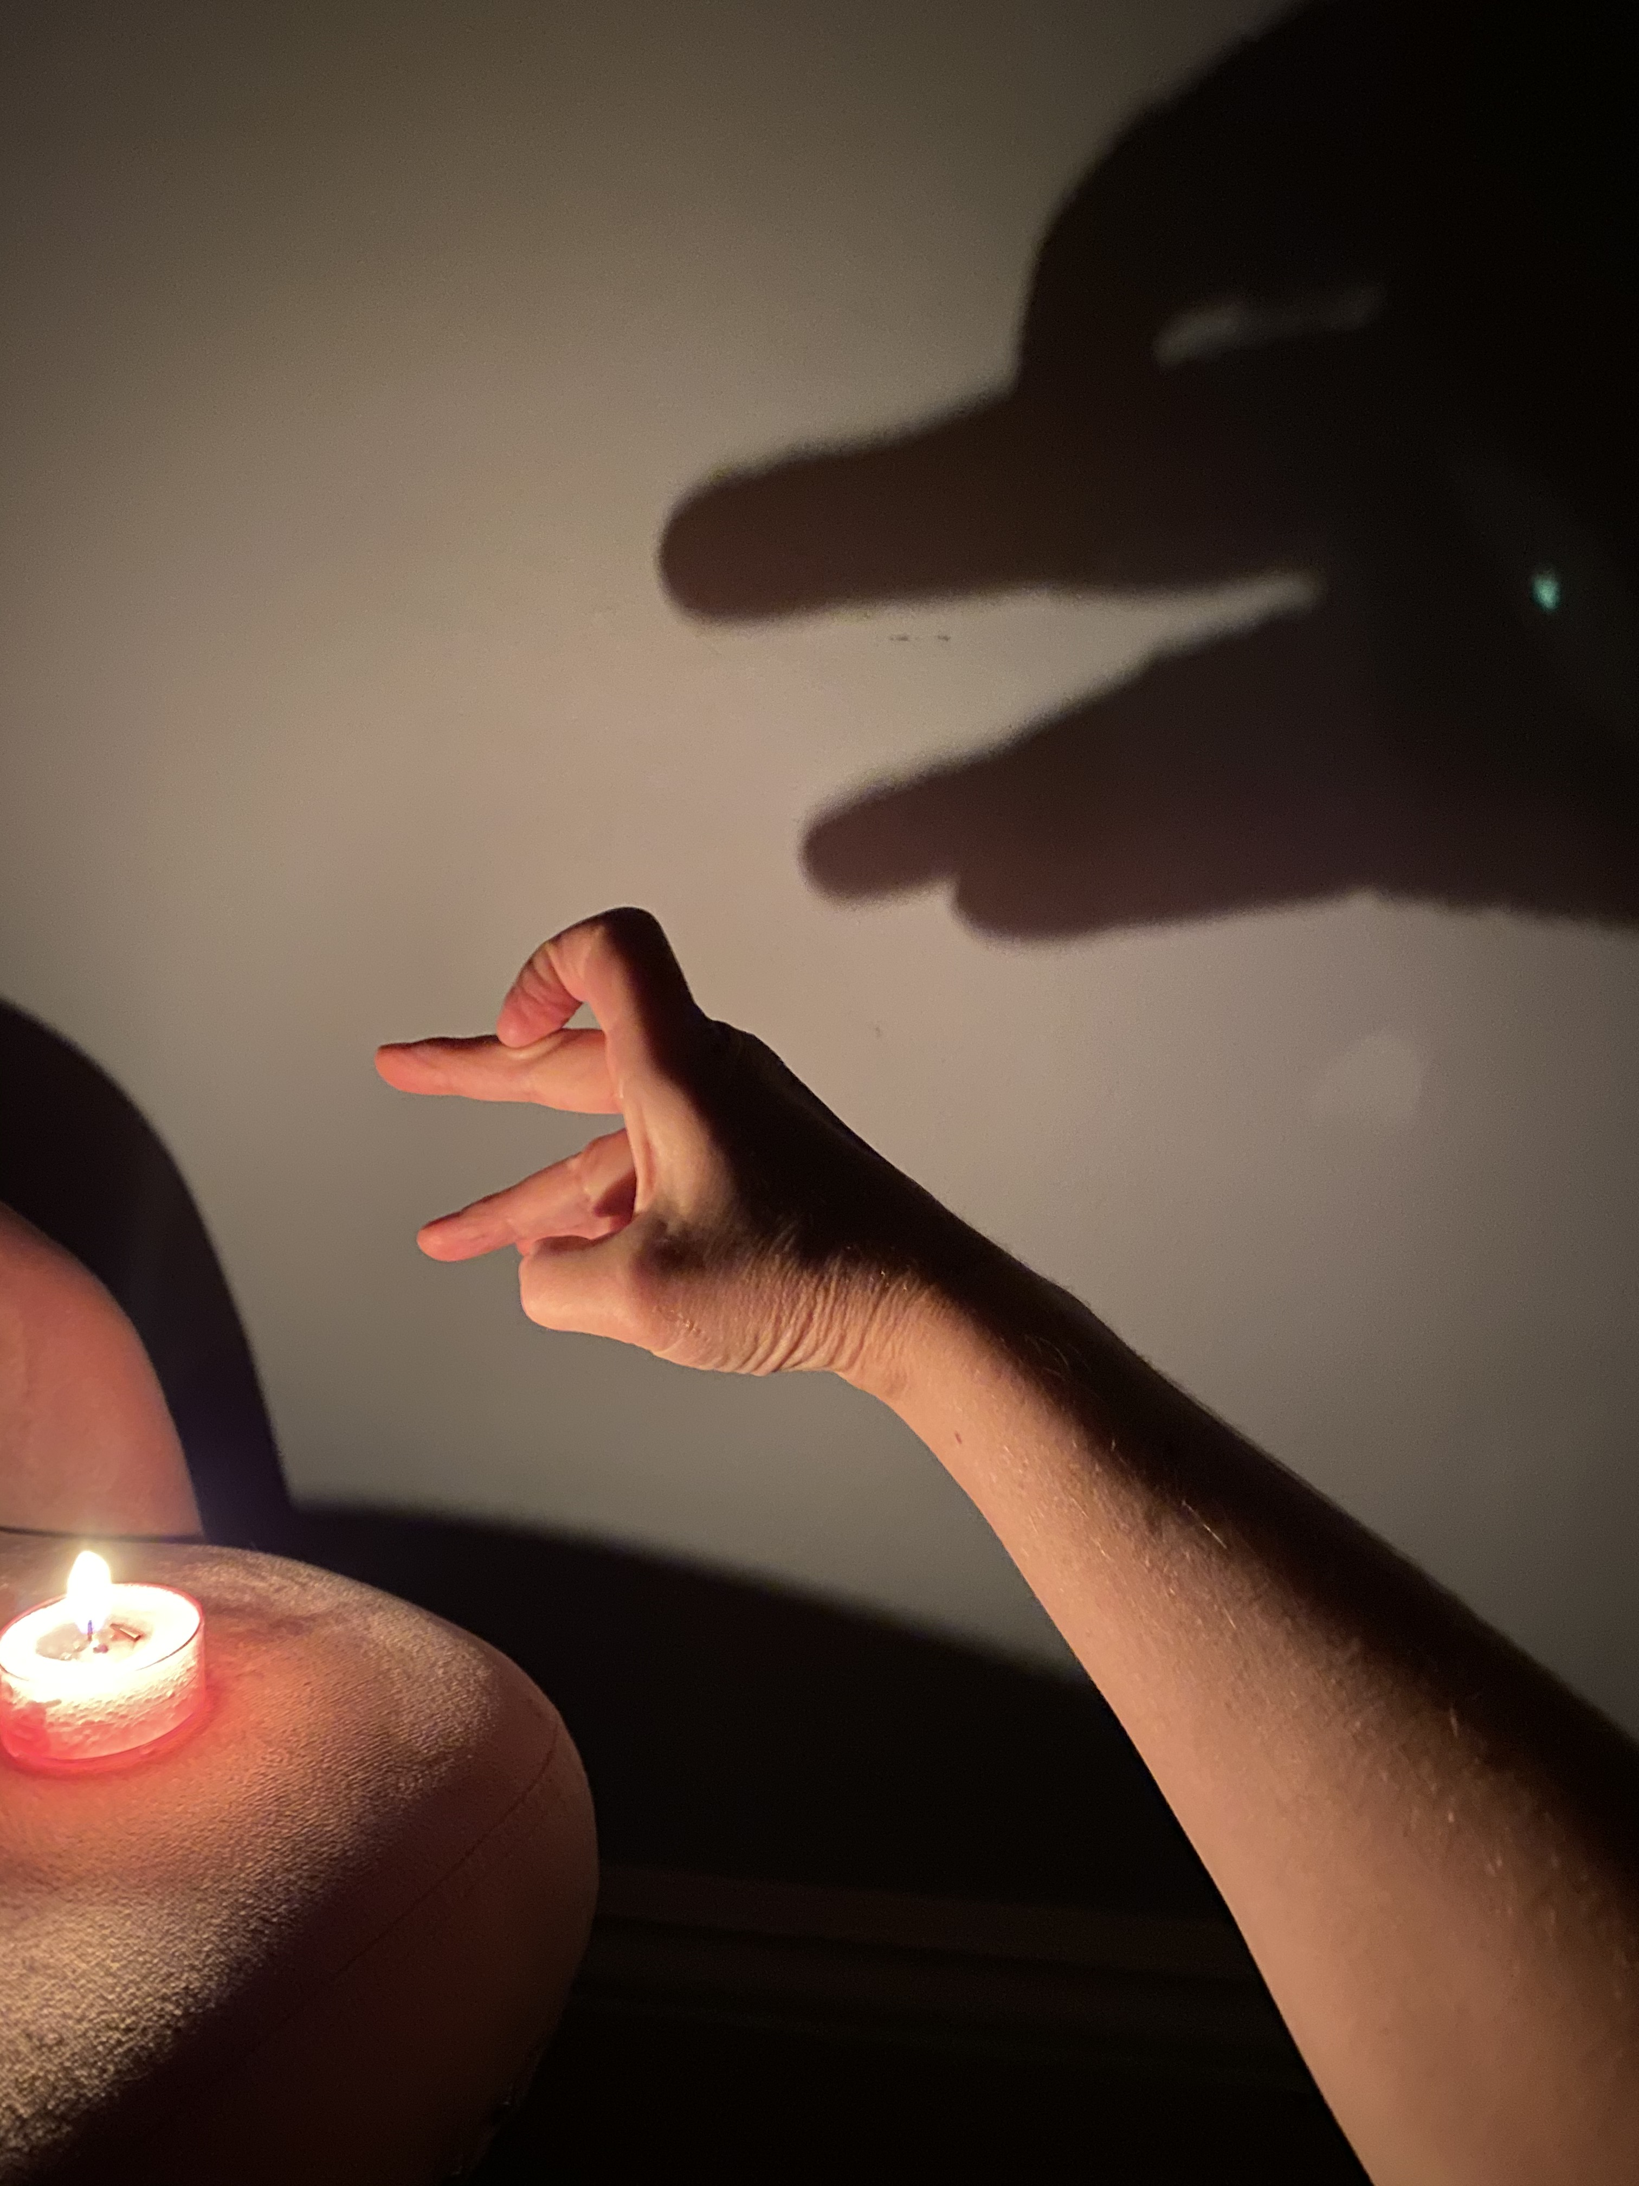
Try it at home with a candle

Slide 11

Let’s breathe new life into this art form with technology
Can you “save” a shadow?
Can you share it?
Let’s try

Slide 12
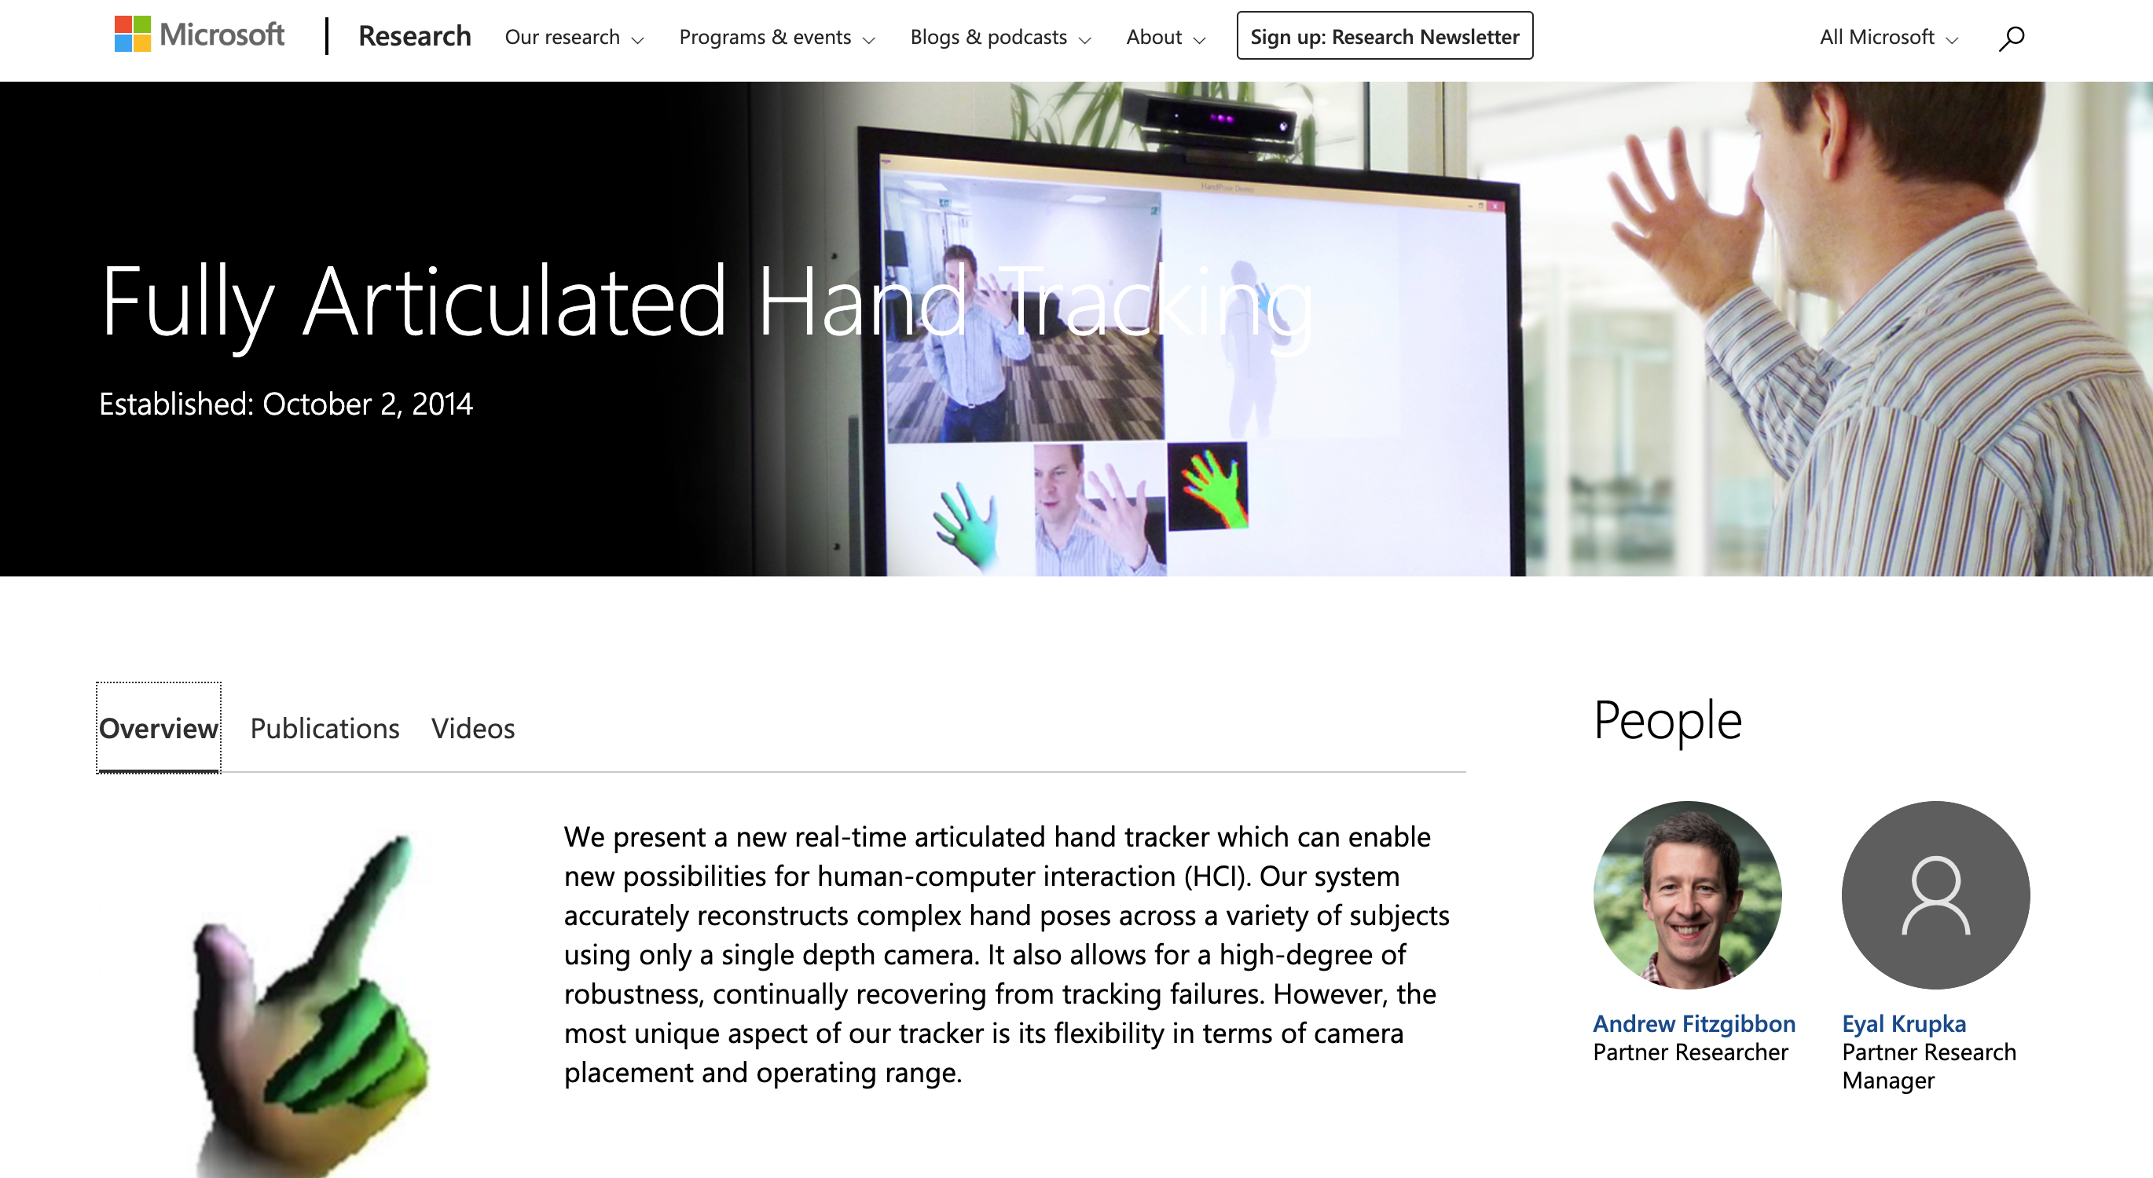
A show of hands

Slide 13
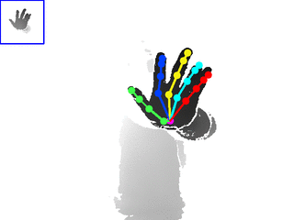
Dozens of Hand-Tracking Libraries, workshops, lists
https://github.com/topics/hand-tracking
https://github.com/xinghaochen/awesome-hand-pose-estimation
https://sites.google.com/view/hands2019/challenge

Slide 14
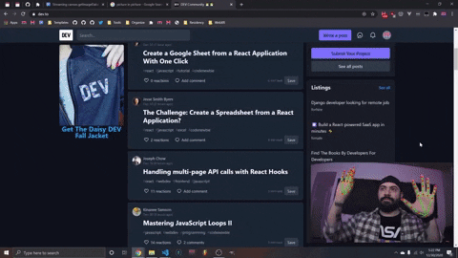
Hand tracking has many uses
Gaming
Simulations / Training
“Hands free” uses for remote interactions with things by moving the body
Assistive technologies
TikTok effects 🏆
Useful things like Accordion Hands (https://mcclanahoochie.com/accordionhands/)
https://handsfree.js.org/

Slide 15
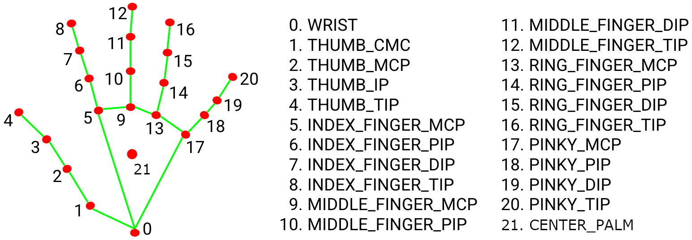
Hands are complicated things
https://arxiv.org/pdf/2006.10214.pdf

Slide 16
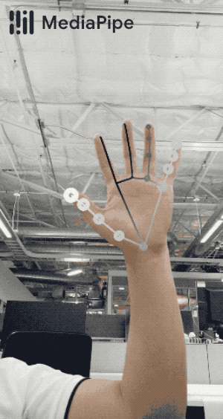
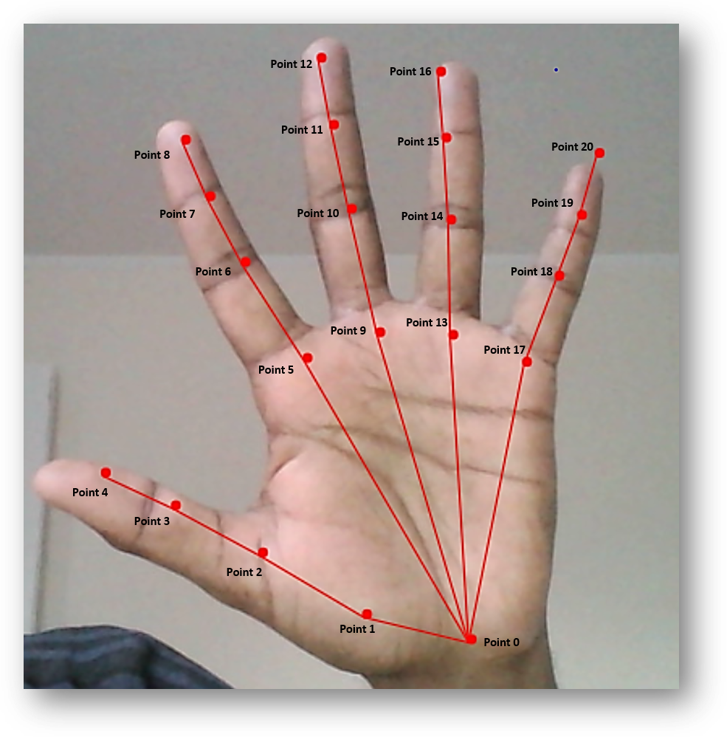
To use on the web, 2 main libraries
TensorFlow.js
MediaPipe
New! HandsFree.js, using both!
Fingerpose: for sign language:
https://github.com/andypotato/fingerpose

Slide 17
A technical challenge
Palms are harder to detect than faces, which have more features to pick out
Hands have more datapoints than bodies! (21 for 1 hand vs. 17 for a body)
Hands come in all different sizes
Dataset is gathered from real world images and synthetic rendered images

Slide 18
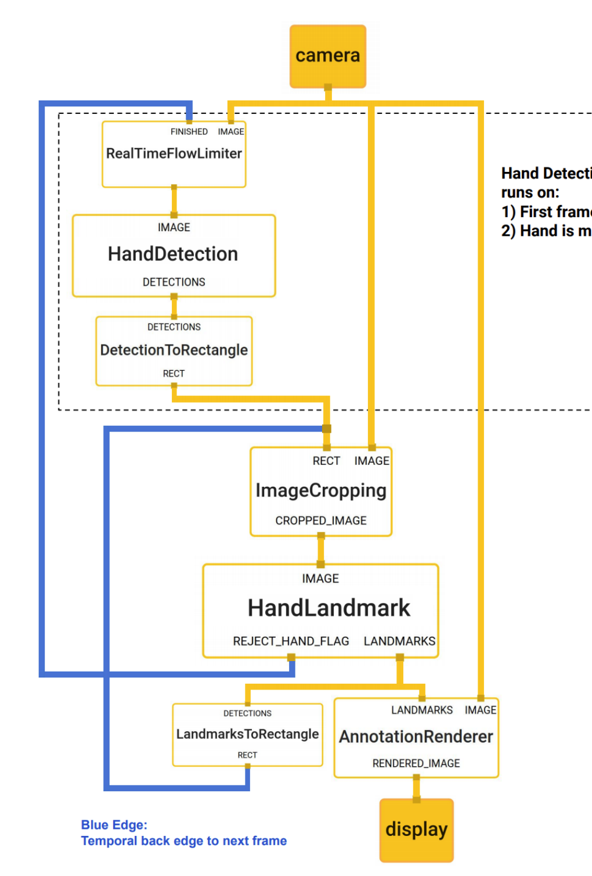
MediaPipe Hands (used by TensorFlow.js)
Multiple ML models
Palm Detection (BlazePalm) on full image returns a hand bounding box
Hand Landmark model operates on cropped image region and returns 3D hand keypoints
Efficient because using 2 models reduces need for data augmentation (crop/rotate/scale)
Network can dedicate its capacity towards prediction accuracy
Pipeline is implemented as MediaPipe graph

Slide 19
We need…
2 hands to show 🤚✋ (MediaPipe via npm)
Ability to style the shadow hand 🎨 (TensorFlow.js via npm)

Slide 20
Let’s try TensorFlow.js and hope for multi-hand support soon
MediaPipe doesn’t allow much styling of the hand skeletons; the purpose is more mechanical than artistic
TF.js is only one hand but you can get as creative as the Canvas API allows
Let’s go!

Slide 21
What we’re going to build
A virtual shadowgraphy show
Leverage the webcam to show hand poses
‘Cast’ those poses, styled like shadows, onto a canvas
Allow the user to record these shadows as a downloadable story

Slide 22
Design/Architecture decisions
Base architecture
Managing webcam
Implementing Handpose model inference
Casting shadows
Deployment

Slide 23
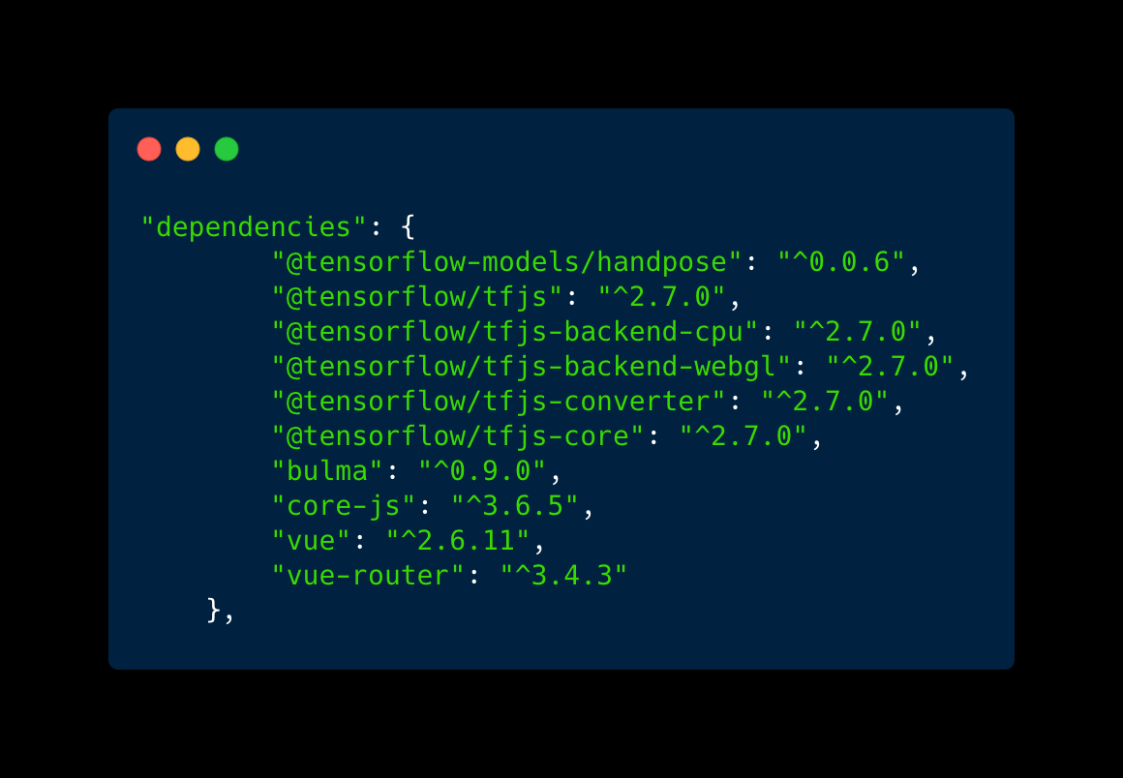
Design/Architecture
Vue.js
Bulma with SASS for styling
Tensorflow.js
Tensorflow’s Handpose model

Slide 24
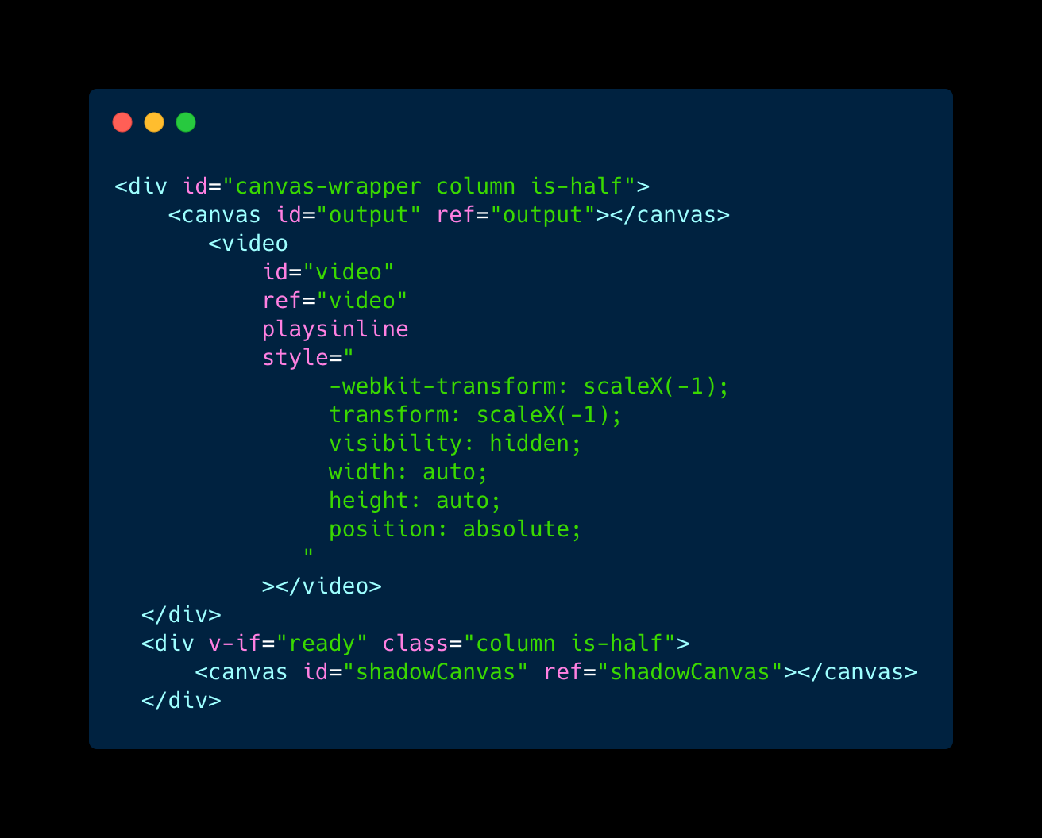
View Setup
Hands are drawn onto the output canvas from the video input; shadows are cast to shadowCanvas

Slide 25
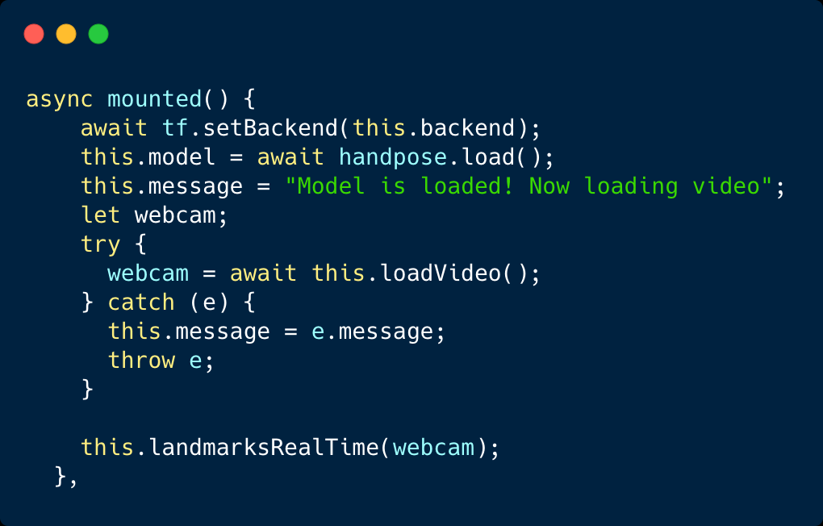
Load model, start Keyframe input
These processes take time, so work asyncronously

Slide 26
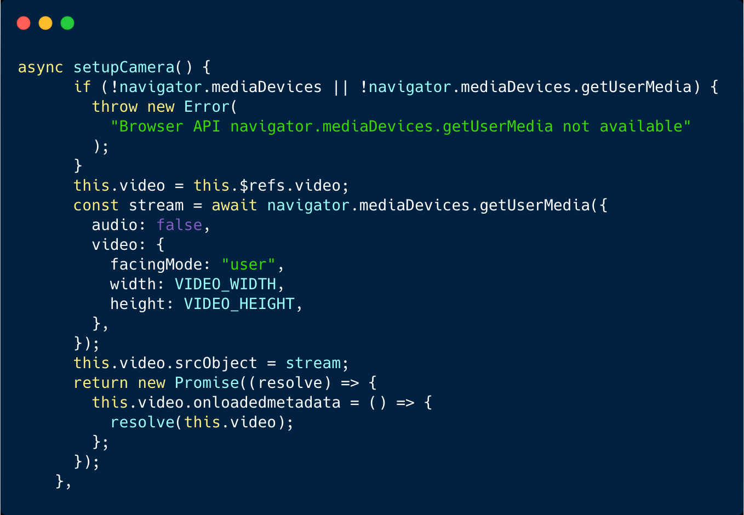
Launch WebCam
Make sure to handle unavailable cameras, and again work asyncronously

Slide 27
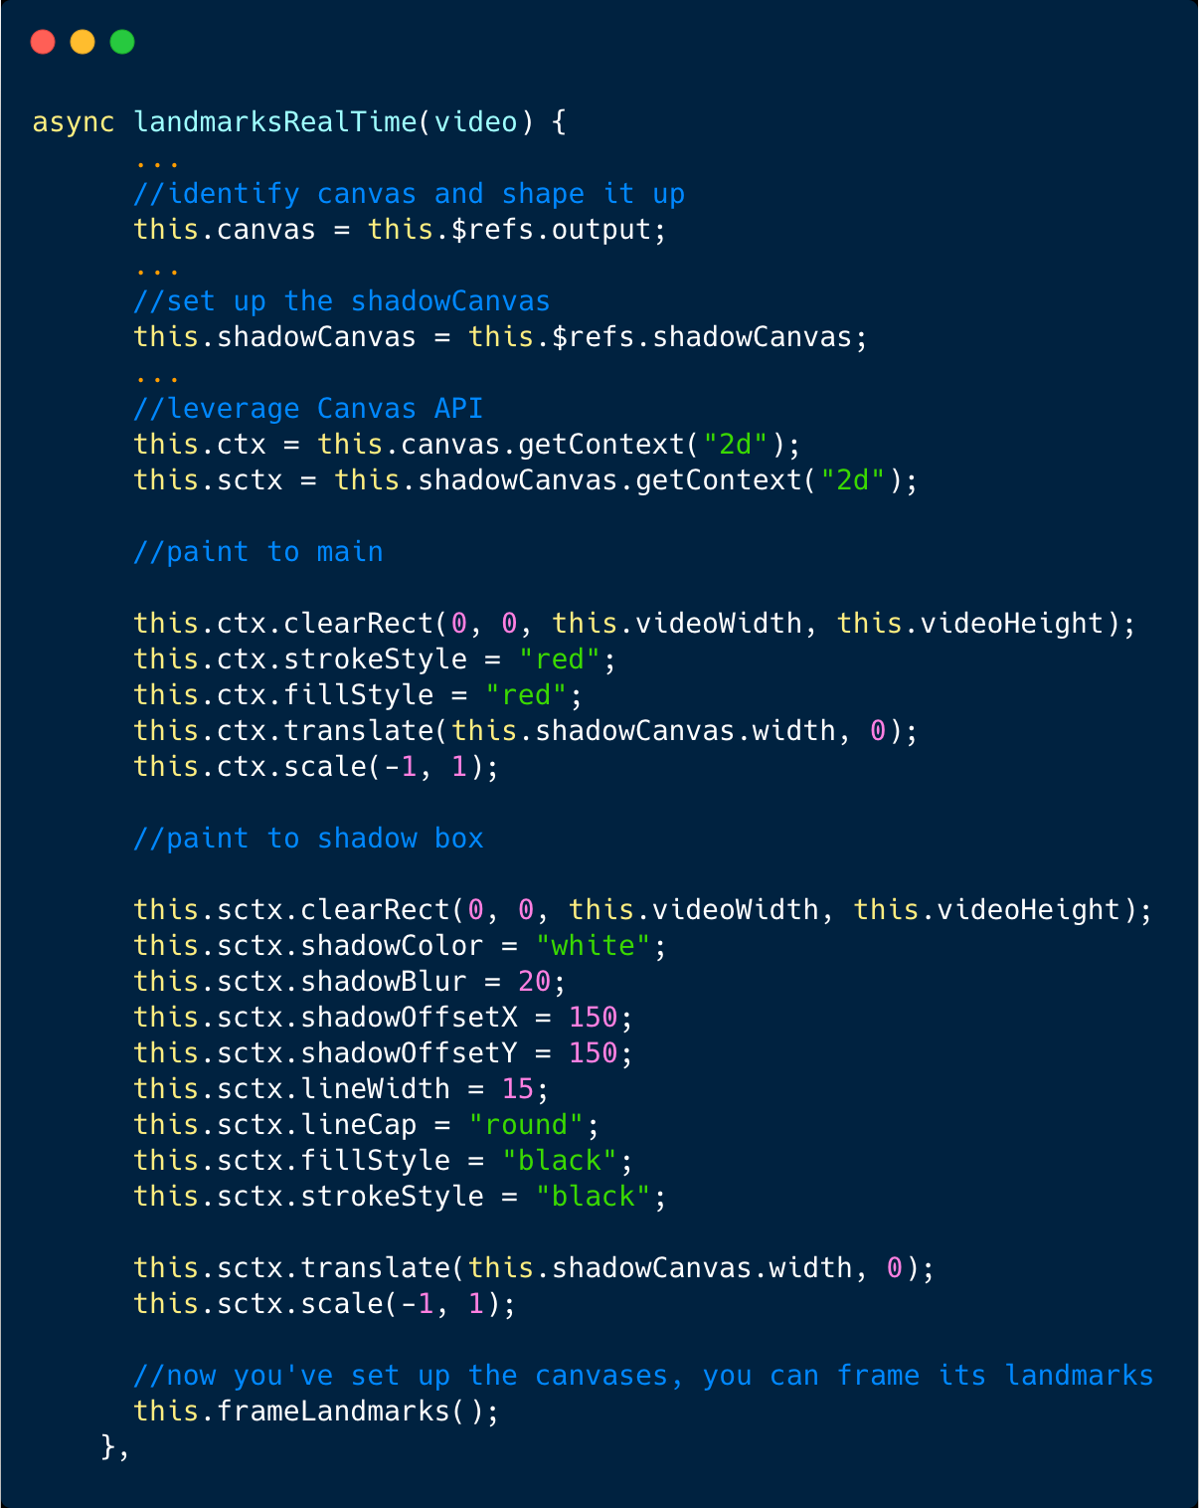
Design the hands and Shadows
Use the Canvas API to add spooky style

Slide 28
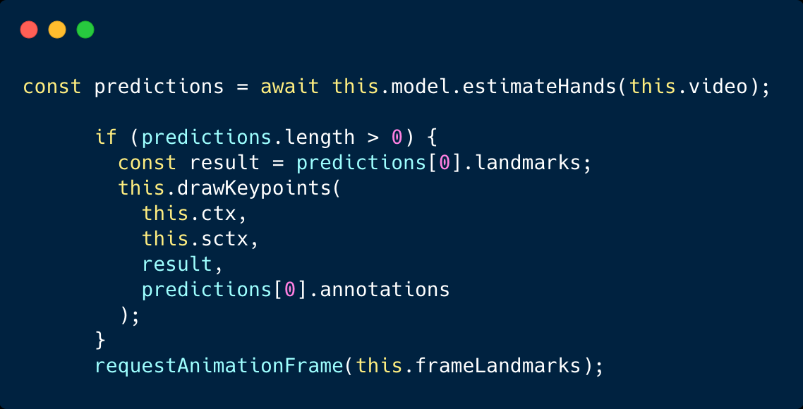
For each frame in the webcam, draw keypoints
Clear the canvases each keyframe and redraw

Slide 29
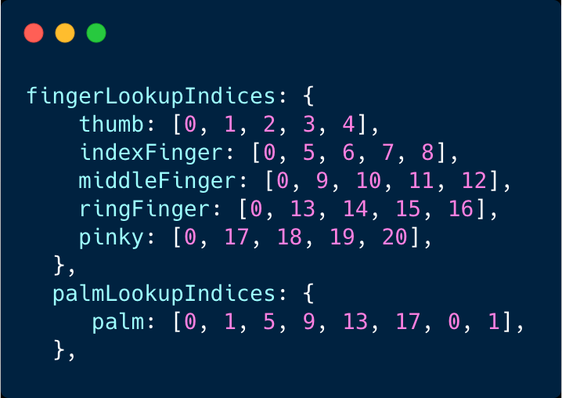
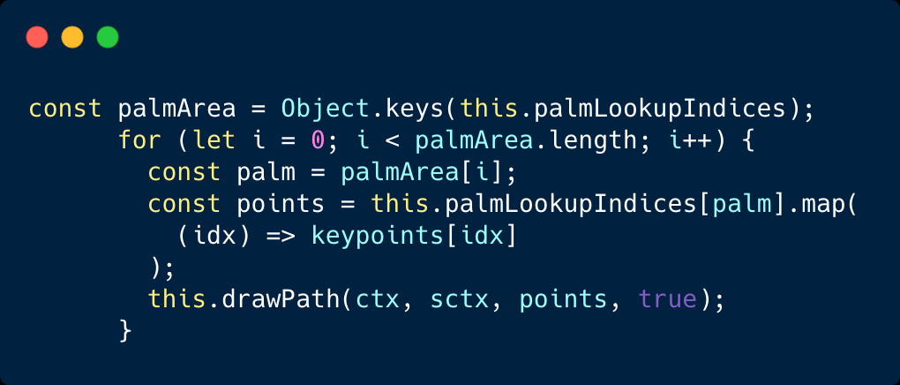
Make the Keypoints and line connectors ‘handlike’
Map fingers to model’s returned data – you can redraw the palm like this

Slide 30
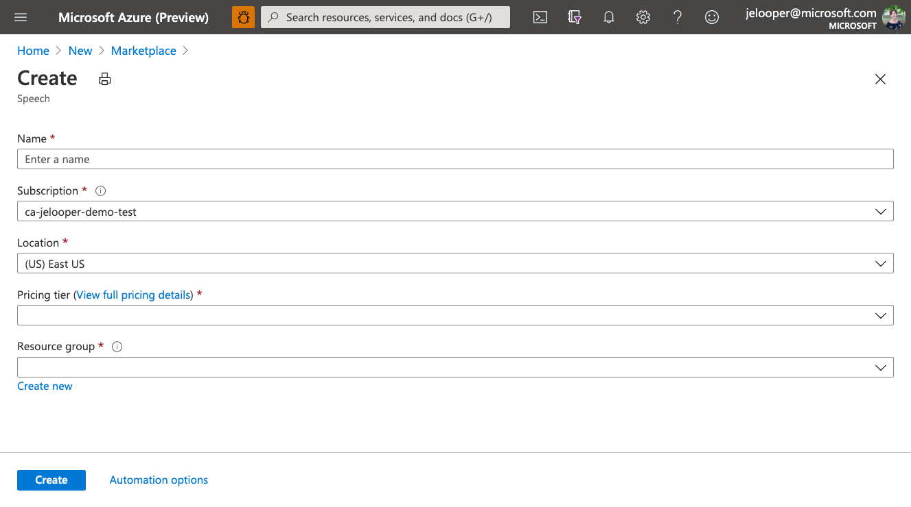
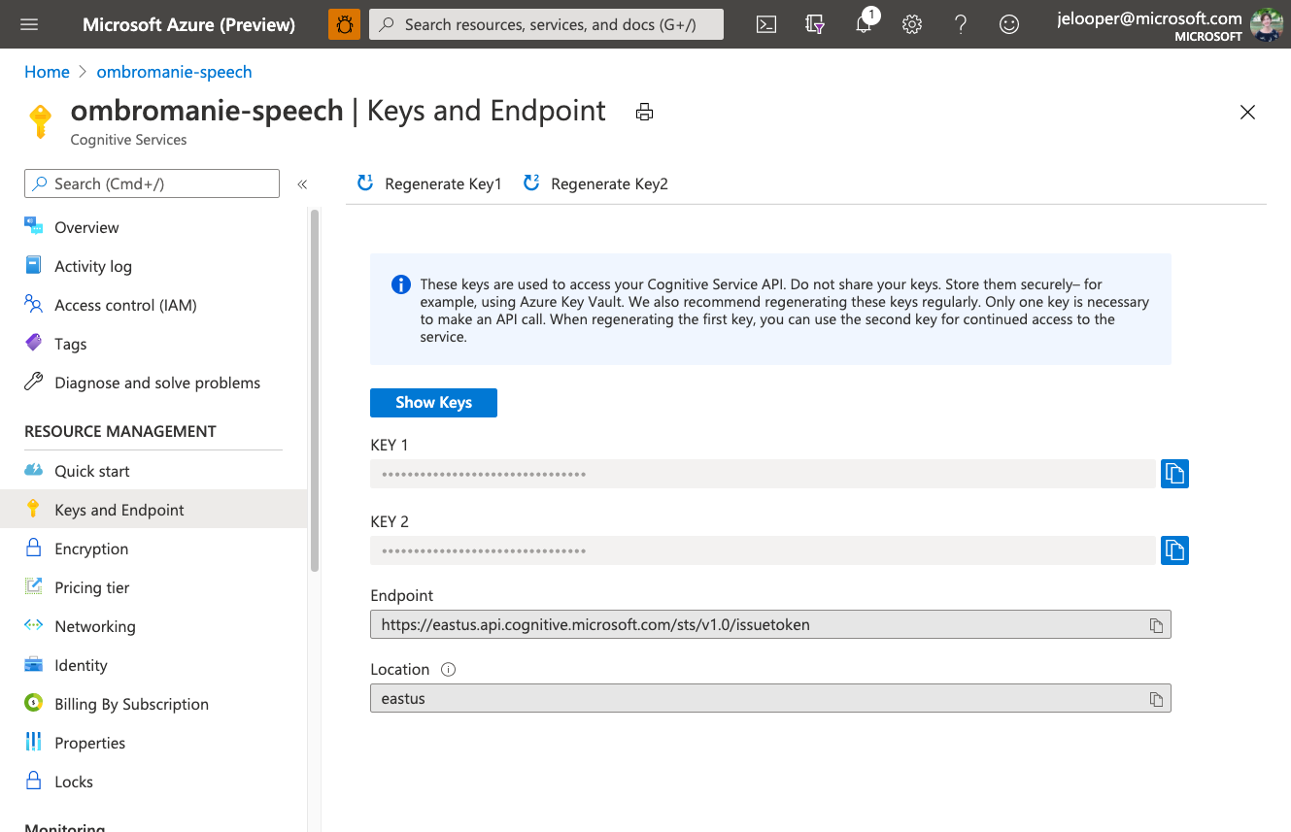
Tell your story!

Slide 31
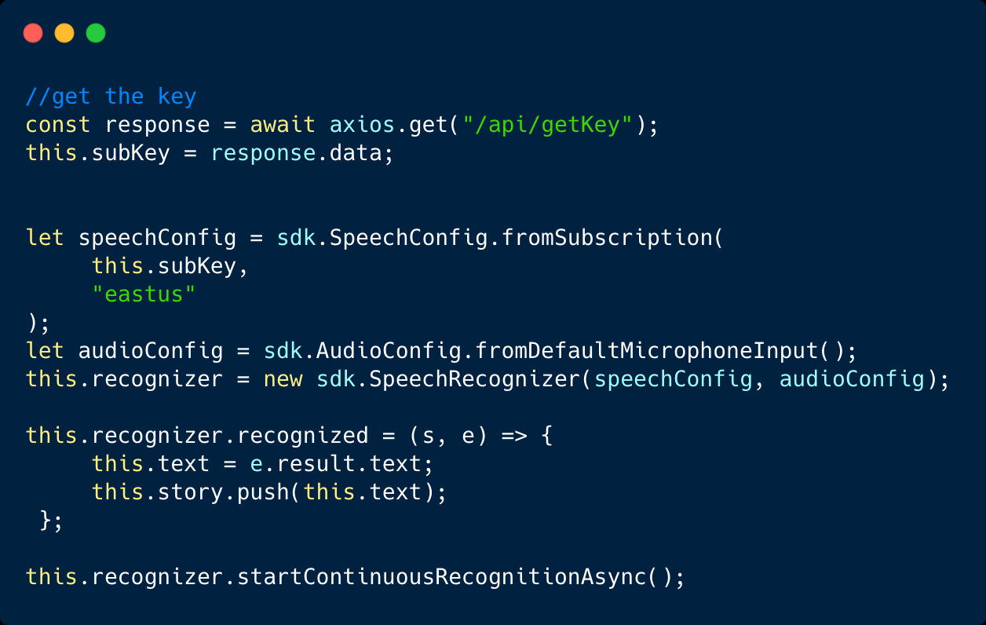
Connect to Speech Service (Cognitive Service)

Slide 32
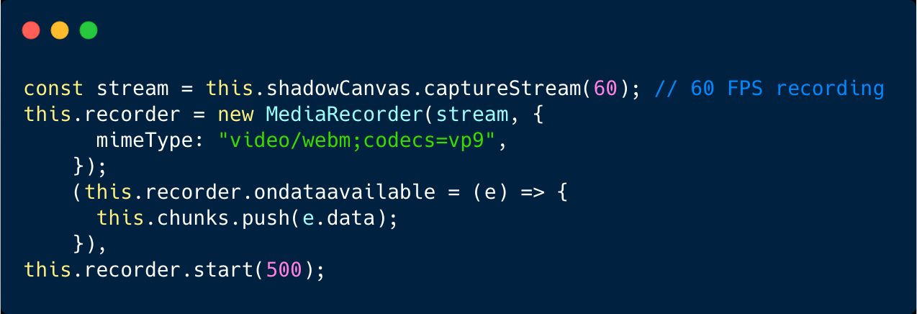
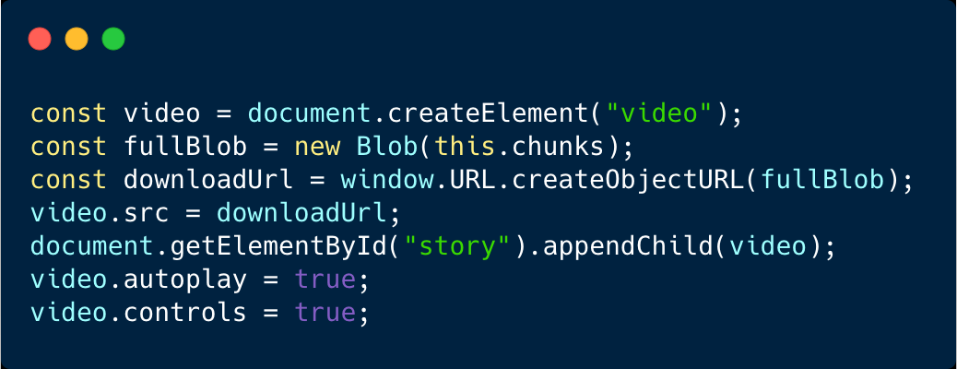
Create videos
Sneaky!

Slide 33
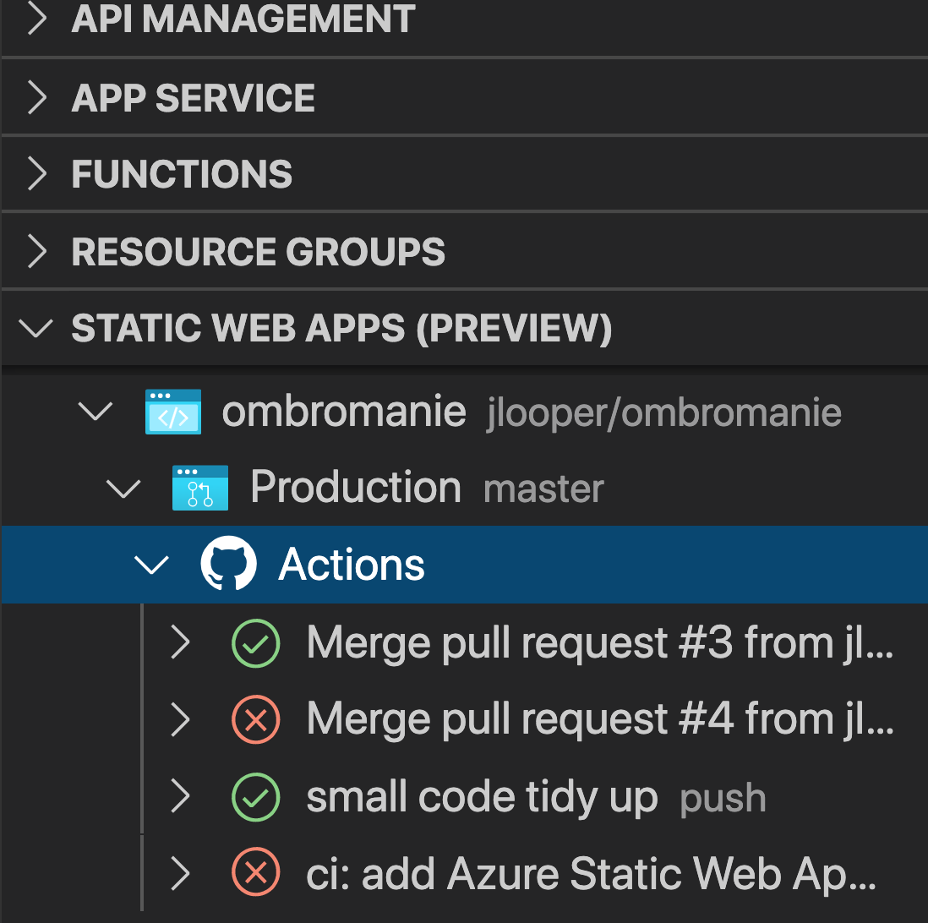
Deployment
Where will this app live?
Azure Static Web Apps!
Deploy from within VS Code
Store an environment variable in the app portal
Integrate Azure Functions
Quick and easy deployment with GitHub Actions
Works GREAT for Vue.js/ VuePress Static apps and SPAs!
aka.ms/trystaticwebapps

Slide 34
Ombromanie with me
A good tutorial: https://www.youtube.com/watch?v=Rlfao2KNxDk&ab_channel=BallardInstituteandMuseumofPuppetry

